Slide 1
Confidence Intervals

Slide 2
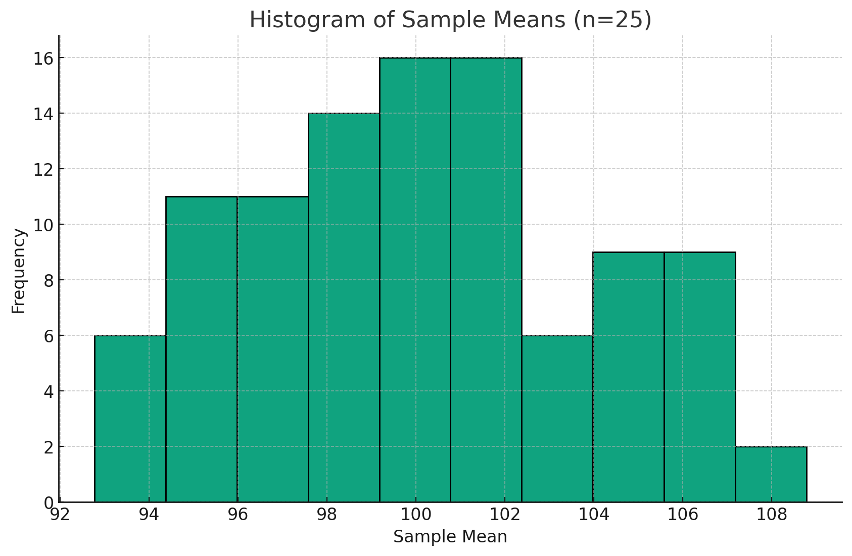
Point Estimates
Point Estimate: A single value estimate of a population parameter.
As we’ve seen, each sample statistic is likely to differ from the population parameter.
We may want/need a way to quantify this variation…
That’s where confidence intervals come in!
population mean = 99.72, 100 samples, max mean = 108.26, min mean = 92.26

Slide 3
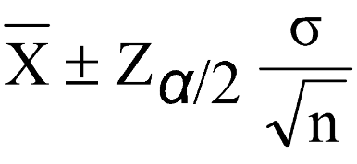

Assumptions and Formula
Assumptions:
Population standard deviation is known
Sample is normally distributed or larger than n = 30
Margin of Error = CV * SE
Upper bound = Sample Mean + MOE
Lower bound = Sample Mean - MOE

Slide 4
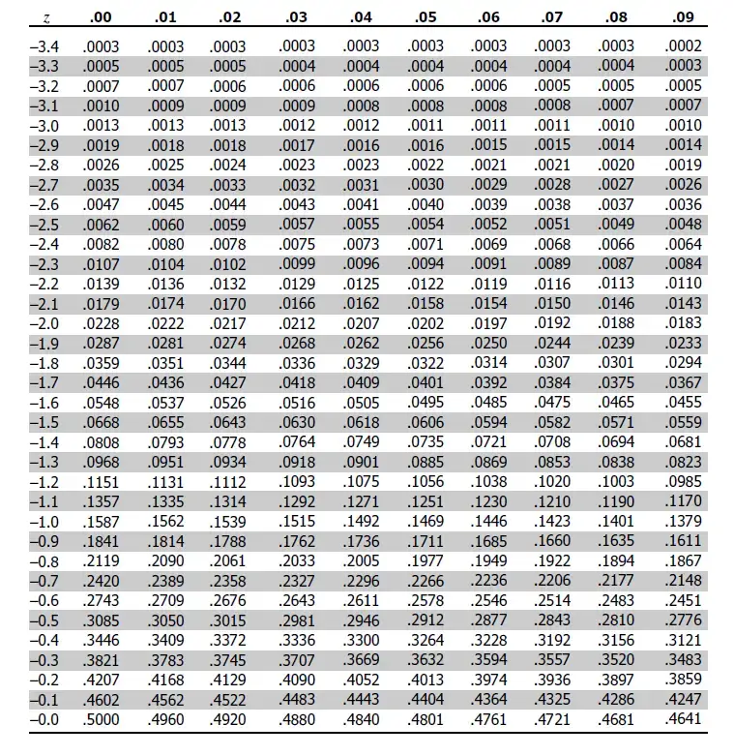
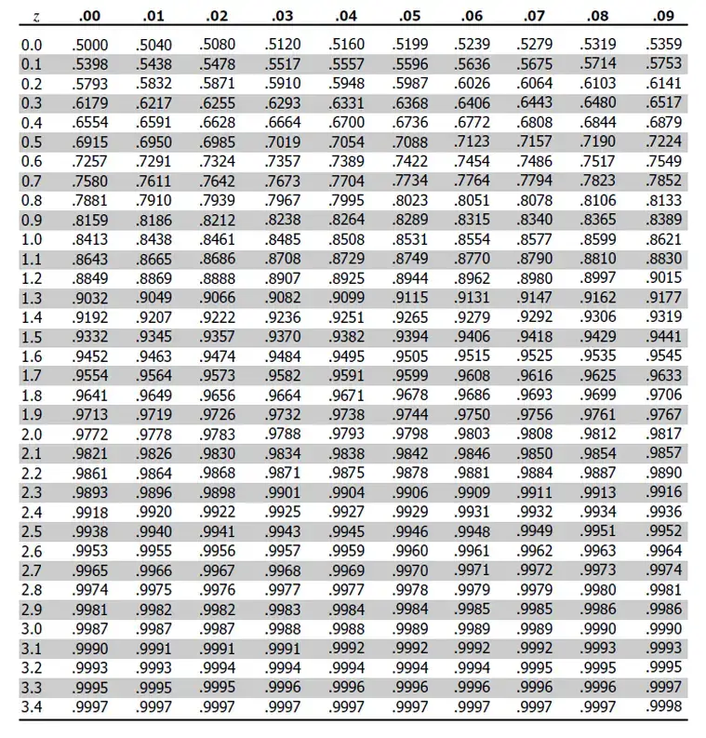

Slide 5
What are Confidence Intervals?
Confidence Interval Interpretation: If the same population were sampled repeatedly and confidence intervals were constructed in the same way each time, 1-Alpha % of the intervals constructed would contain the true population parameter being estimated.
Confidence intervals are a measure of the reliability of the estimate, with narrower intervals indicating a better estimate.

Slide 6
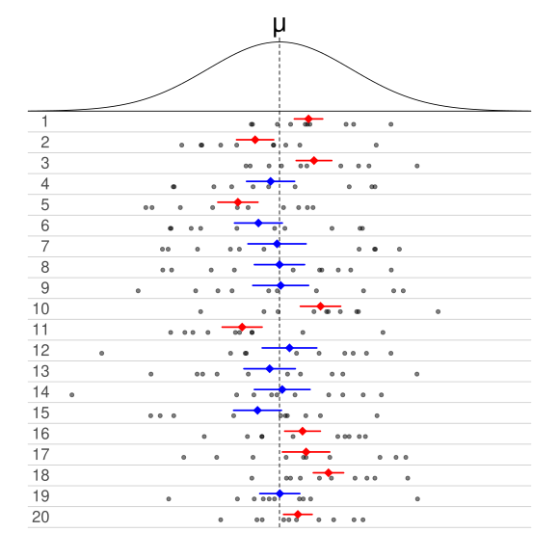
Interpreting Confidence Intervals
Of 20 samples, 20 sample means, and 20 confidence intervals…
None are equal to the actual population mean, as we would expect, due to sampling error
Of the 20 intervals, 10 contain the actual population parameter being estimated
Ergo, this table shows intervals for 50% confidence (if correctly constructed)

Slide 7
What AREN’T Confidence Intervals
Confidence intervals are constantly misinterpreted.
Incorrect interpretation:
There is a 1-Alpha % chance that the true population mean falls within the interval

Slide 8
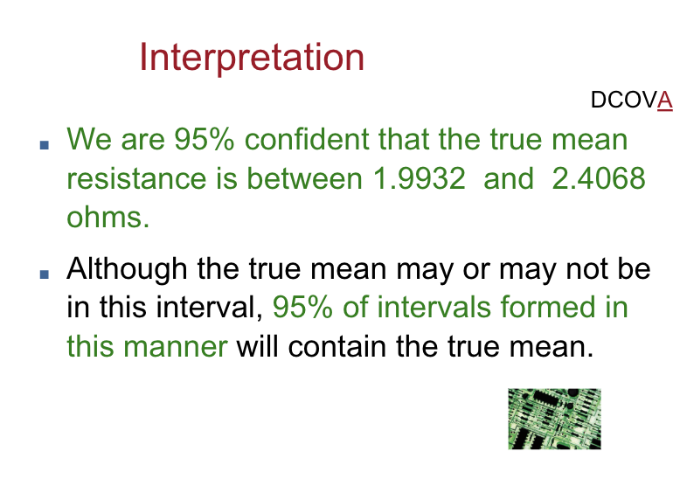
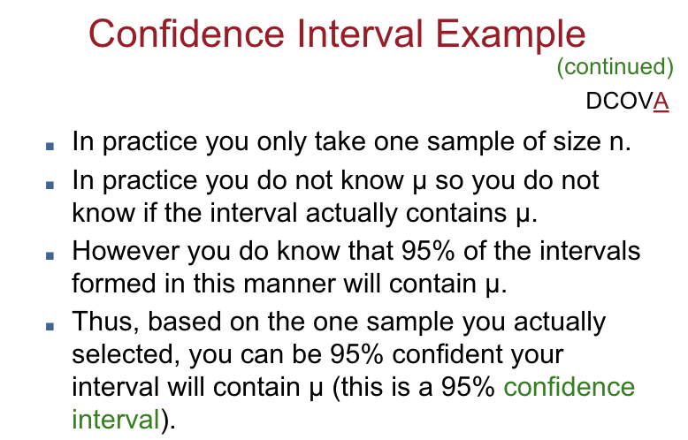
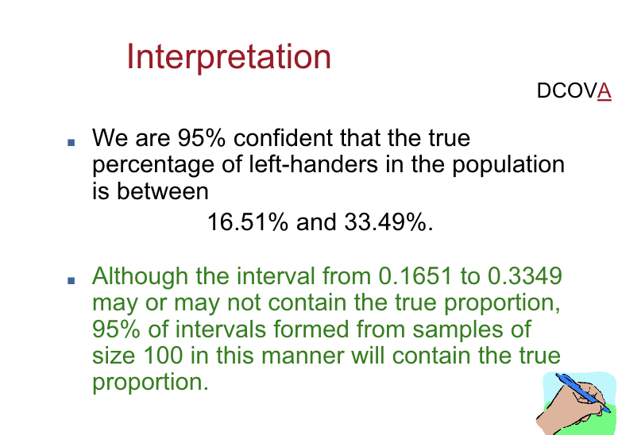

Slide 9
Example
Upper Bound =
100 + 1.96 * (15 / sqrt(81)) =
100 + 1.96 * 1.67 =
100 + 3.27 = 103.27
Lower Bound =
100 - 1.96 * (15 / sqrt(81)) =
100 - 1.96 * 1.67 =
100 - 3.27 = 96.73
Sample Mean: 100
Sample Size: 81
Population Standard Deviation: 15
Confidence = 95% / Alpha = 5%
Alpha / 2 = 2.5%
CV from Z Table = 1.96

Slide 10
Confidence Intervals With Z - Using Excel
Method 1:
Margin of Error =confidence.norm(alpha, population standard deviation, sample size)
Add/subtract MOE to/from the sample mean to get intervals
Method 2:
Z Critical Value = norm.s.inv(1-alpha)
Standard Error = stdev.p(x) / sqrt(n)
Margin of Error = CV * SE
Add/subtract MOE to/from the sample mean to get intervals

Slide 11
Confidence Intervals With Z - Using Python
import scipy.stats as stats
import numpy as np
x = [1, 2, 3, 4, 5]
mean_x = np.mean(x)
stdev_x = np.std(x)
n = len(x)
sqrt_n = np.sqrt(n)
cv = stats.norm.ppf(1-(alpha/2))
se = stdev_x / sqrt_n
moe = se * cv
upper = mean_x + moe
lower = mean_y - moe

Slide 12
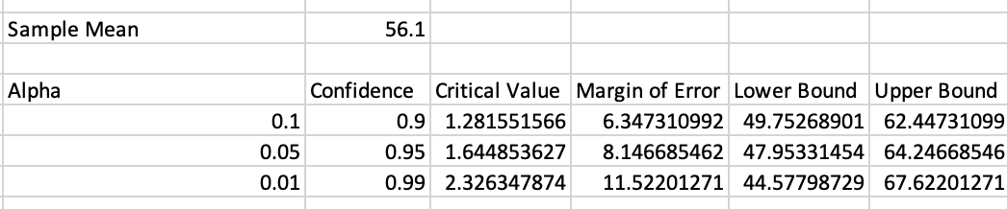
Confidence vs Interval Size
How do intervals relate to confidence?
Higher confidence = More likely to contain the population parameter
More likely to contain the population parameter = Wider!

Slide 13
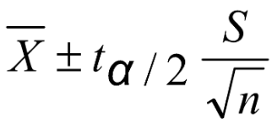
What if you don’t know the population standard deviation?
You almost never will!
In this case use the T-Distribution instead of Z-Distribution
Use sample standard deviation instead of population standard deviation
T is “parameterized” by alpha, sample size, tails (1 vs 2), and degrees of freedom
DOF = n - 1
Tails = 2

Slide 14
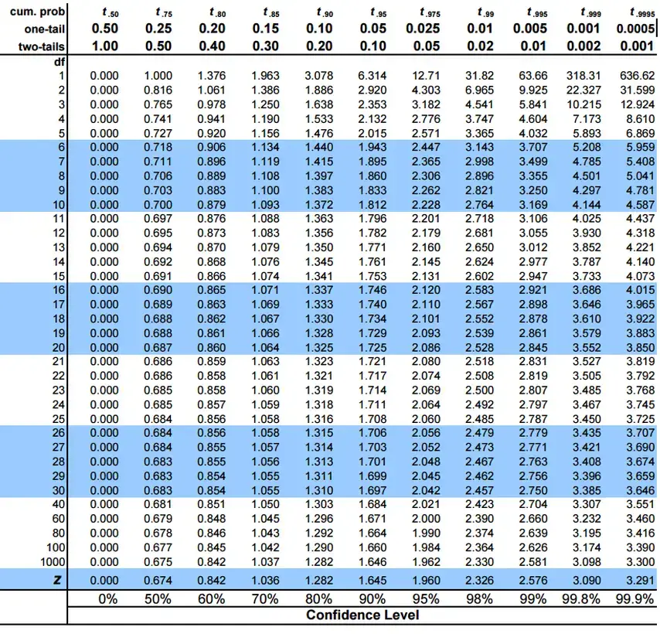

Slide 15
Example
Upper Bound =
50 + 2.064 * 3 / 5
MOE = 2.064 * 0.6 = 1.23
50 + 1.23 = 51.23
Lower Bound =
50 - 1.23 = 48.77
Sample Mean: 50
Sample Size: 25
Sample Standard Deviation: 3
Confidence = 95% / Alpha = 5%
Alpha / 2 = 2.5%
CV from T Table = 2.064

Slide 16
Confidence Intervals With T - Using Excel
Method 2:
T Critical Value = t.inv(1-alpha)
Standard Error = stdev.p(x) / sqrt(n)
Margin of Error = CV * SE
Add/subtract MOE to/from the sample mean to get intervals
Method 1:
MOE =confidence.t(alpha, sample standard deviation, sample size)
Add/subtract MOE to/from the sample mean to get intervals

Slide 17
Confidence Intervals With T - Using Python
Python w/ Scipy
import scipy.stats as stats
import numpy as np
x = [1, 2, 3, 4, 5]
mean_x = np.mean(x)
stdev_x = np.std(x)
n = len(x)
sqrt_n = np.sqrt(n)
cv = stats.t.ppf(1-(0.05/2), df=n-1)
se = stdev_x / sqrt_n
moe = se * cv
upper = mean_x + moe
lower = mean_y - moe

Slide 18
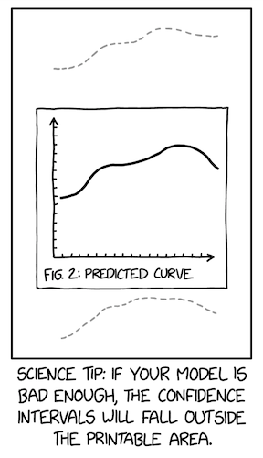

Slide 19
Necessary Sample Size

Slide 20
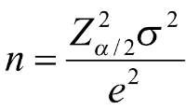
Necessary Sample Size
For a confidence level and an acceptable margin of error, how large must our sample be?
e = margin of error (added and subtracted to get confidence intervals)
n = necessary sample size

Slide 21
Necessary Sample Size Example
Standard Deviation = 45
If you wanted to know the mean +/-5 at the 90% confidence level, you’d need…
(1.645^2 * 45^2) / 5^2 = 219.19
Round up to 220
n must be at least 220

